Slide 1

Proofs
Lecture 6.5
Examples of Disproof
By Ariel A.

Slide 2
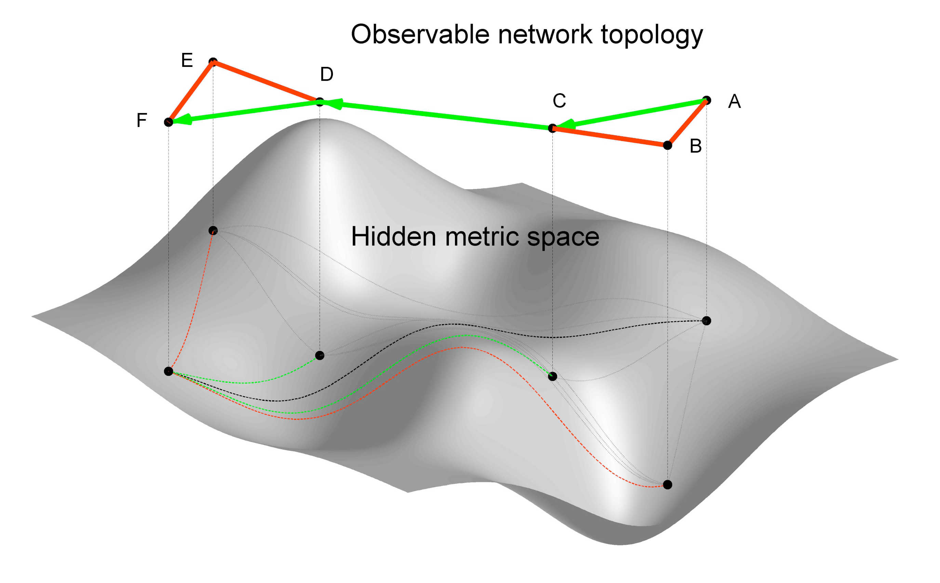
Prove or Disprove: If x, y ∈ ℝ, then |x + y| = |x| + |y|.
Spend a few minutes and try to see what this problem is really saying…

Slide 3

The Triangle Inequality
This is one of the most important theoretical concepts in mathematics
It is one of the three rules required to prove that the set you’re working with is a metric space
A metric defines the concept of distance between any 2 members of the set you’re in (sets like ℝ or ℕ)

Slide 4
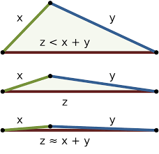
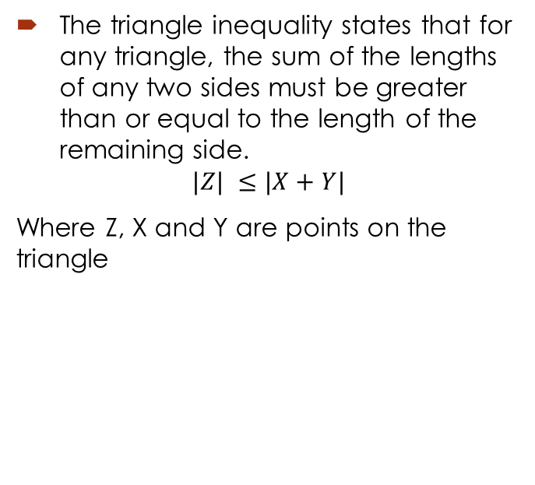
So what is it?
The triangle inequality states that for any triangle, the sum of the lengths of any two sides must be greater than or equal to the length of the remaining side.
$$|Z| ≤|X+Y|$$
Where Z, X and Y are points on the triangle

Slide 5

Fun Stuff: Defining a Metric Space (-:Not Required:-)
To define a metric space on a set we need to satisfy 3 (technically 4) conditions:
The distance d from a point to itself is 0. $d\left(a,a\right)=0, ∀a ∈S$
The distance $d\left(a,b\right)=d\left(b,a\right) ∀a,b ∈S$ (equivalent distances).
The distance between 2 distinct points is positive. $d\left(a,b\right)>0, ∀a,b ∈S$
The distance from A to B is less than or equal to the distance from A to B via a third point C. $d\left(a,c\right)≤d\left(a,b\right)+d\left(b,c\right), ∀a,b,c ∈S$

Slide 6
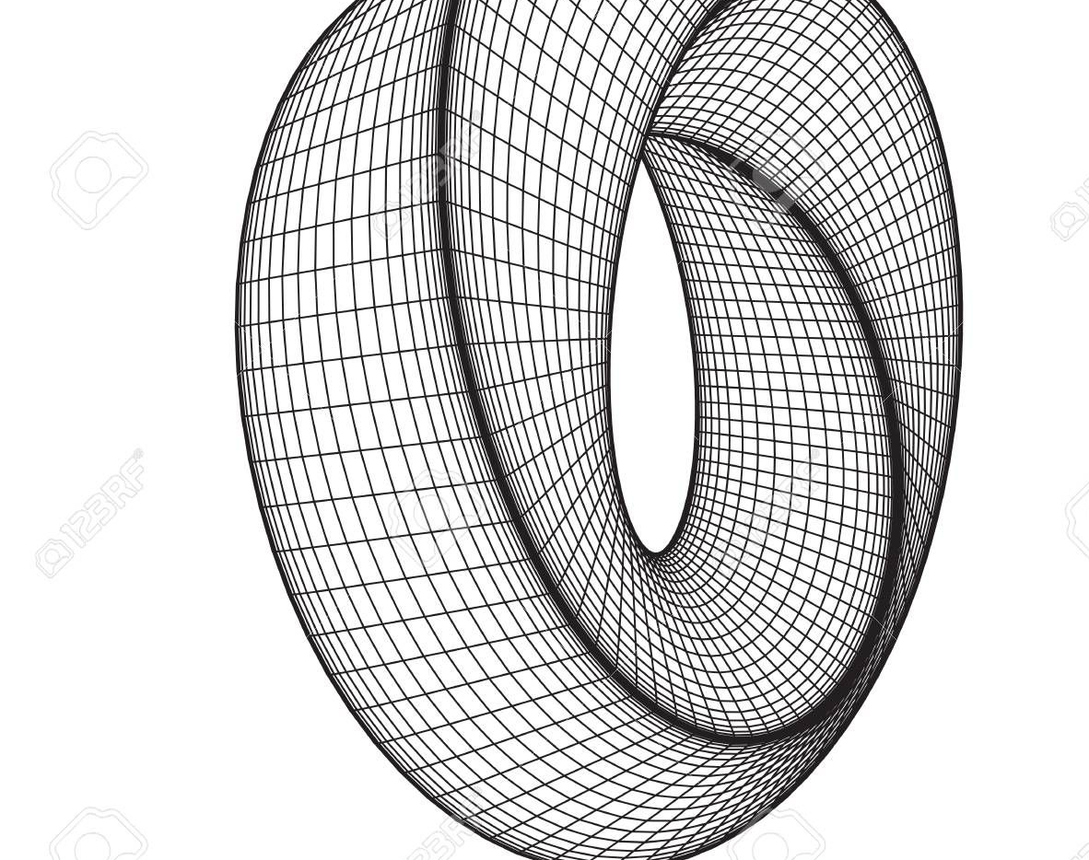
So what does that mean?
Given a distance function, we can determine if it allows us to measure the distance between any 2 points on a set
Like the function |x-y| can be used as a metric for the ℝ
All the way to doing awesome stuff like measuring the difference between microbial samples or customers

Slide 7


So is x, y ∈ ℝ, then |x + y| = |x| + |y| true?
Its False!
Pick x = 5 and y = -5
Then $\left|x+y\right|=\left|5 −5\right| ≠\left|x\right|+\left|y\right|=\left|5\right|+\left|−5\right|=0$
This was a disproof by example (there exists an element such that our assumption turns to poo)

Slide 8

Prove or Disprove: For $n ∈\text{ℕ}$, the integer $2n^{2}−4n+31$is prime.
Thinking time…
Still stuck? Think about this…are even numbers greater than 2 prime? Maybe you find a way to make the above formula even?

Slide 9

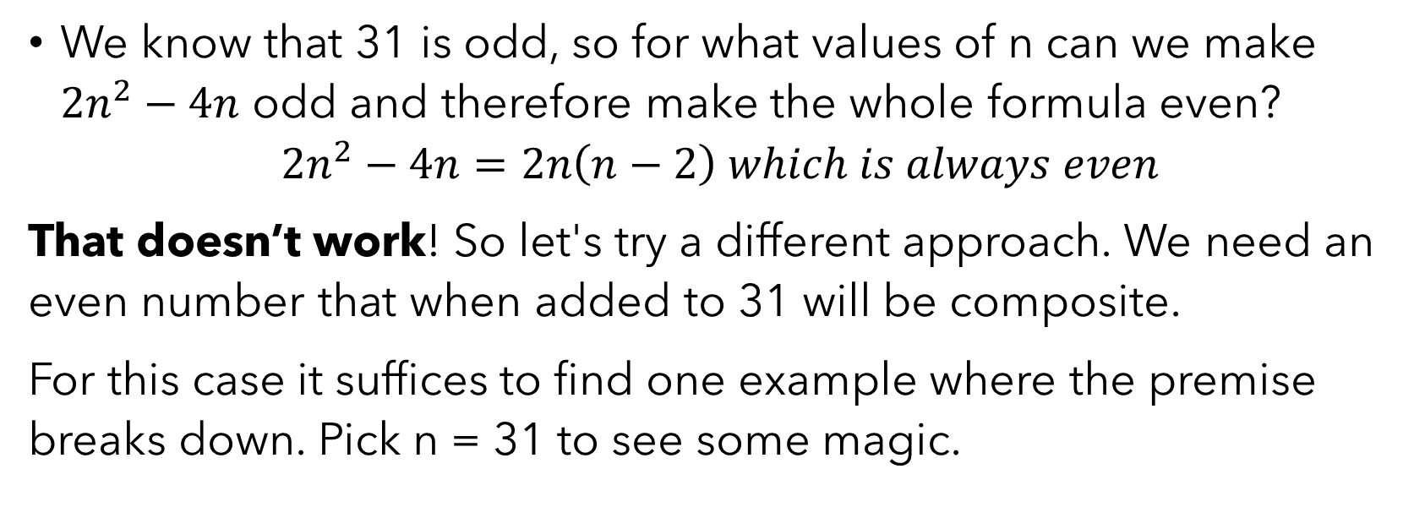
Break it up!
We know that 31 is odd, so for what values of n can we make $2n^{2}−4n$ odd and therefore make the whole formula even?
$$2n^{2}−4n=2n\left(n−2\right) which is always even$$
That doesn’t work! So let's try a different approach. We need an even number that when added to 31 will be composite.
For this case it suffices to find one example where the premise breaks down. Pick n = 31 to see some magic.

Slide 10

Wait WHAT just happened?
Are we just expected to try numbers till we get lucky?
Or write code to hopefully find results?
Or is there some greater intuition we can build here…

Slide 11

Mathematical bread
It turns out that if you have any polynomial with a constant value (31), if you substitute it for the variable, you’ll always have a composite value.
Two rules: the constant is not 1 and the polynomial terms don’t cancel each other out
Essentially, if 31 is a factor of each of the terms, then 31 | (our lovely monster)

Slide 12


Use this anywhere
$$x^{5}+11x^{3}−13x+11$$
$$Set x=11 or 22 or 33 or…11n and this is composite$$
Read on here for a proof

Slide 13

Keep on doing problems
These were just 2 examples from the book
Keep on doing problems because as you’ve seen, its very easy to get lost in logic that just doesn’t work
Doing more problems might help you find the correct insight

